Slide 1

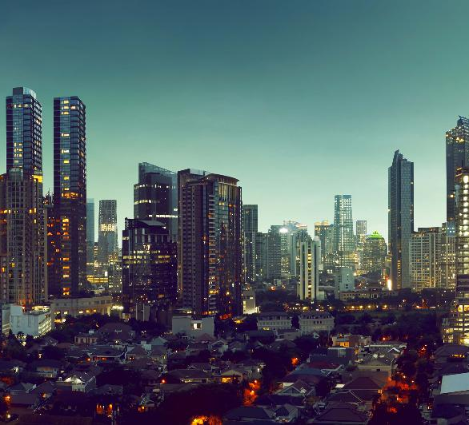

Global Warming
How does it affects our Earth?
The temperature on Earth for now is 58.62 F
Global sea levels are rising 3.2 millimeters a year
Habitat of many animal species become extinct
Farel Arden
CIT Class 6 Batch 2019
Stay Healthy, Stay Biking

Slide 2



Solution
We need transportations that do not spread emission gas
We need transportations that do not use any oil fuel
We need an eco-friendly transportation
Stay Healthy, Stay Biking

Slide 3
The Answer
Stay Healthy, Stay Biking

Slide 4



What does greenbike offers you ?
We give you a facility to find bikes easily
You can find us anywhere
The price is very affordable
Stay Healthy, Stay Biking

Slide 5
Thank you
Stay Healthy, Stay Biking
Contact me: Phone Number : 081281474949
E-mail : greenbike@gmail.com

